Slide 1
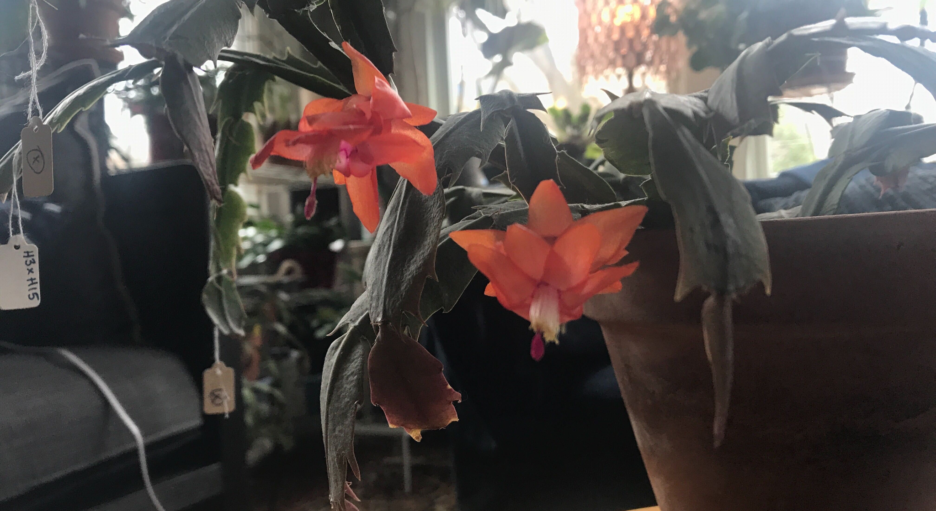
Potexviruses in Cactaceae
Alexa Tyszka

Slide 2
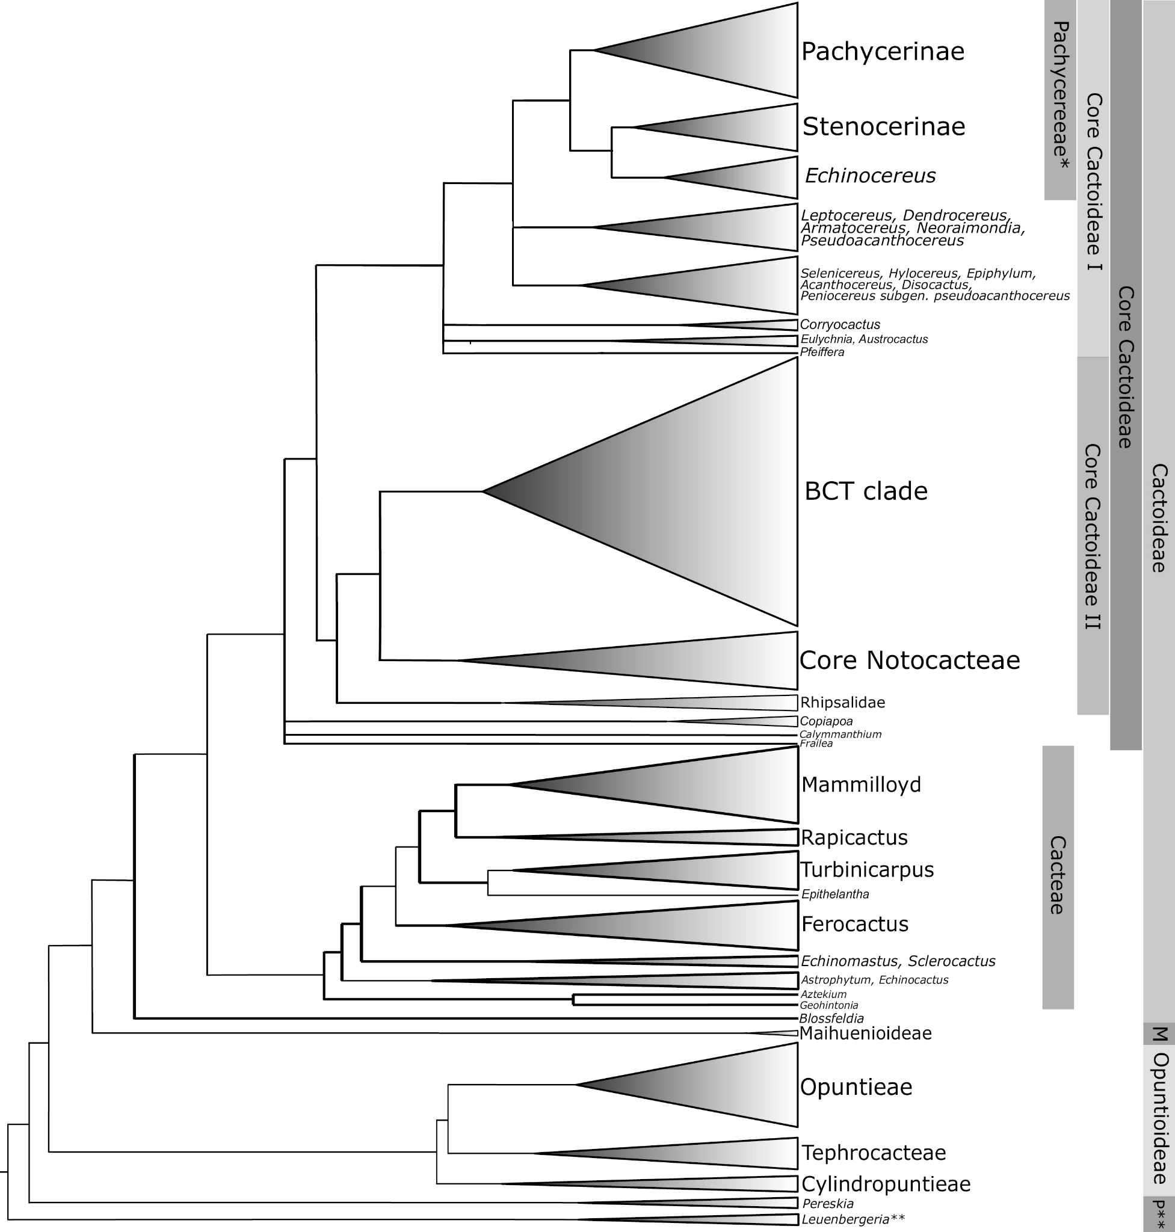
Within Cactaceae…
Potexvirus confirmed host range
Potexvirus unconfirmed potential hosts
Notes:
https://academic.oup.com/jhered/article/110/1/4/5205122
Maliarenko, 2013
Chessin, 2002
Hazelgrove, 1981
Browningieae-Cereeae-Trichocereeae (BCT) clade
“Tribe Trichocereae harbors dozens of genera and hundreds of species, but phylogenetic relationships in this group have been extremely difficult to elucidate. As traditionally circumscribed, molecular phylogenies show this group to be polyphyletic, because early diverging taxa (e.g., Discocactus, Rebutia, Sulcorebutia) are mixed with taxa classified within the Bowningieaee and Cereeae tribes, and molecular phylogenies show they conform to a clade that has been called the BCT clade (Figure 2; Nyffeler 2002; Hernández-Hernández et al. 2011).”

Slide 3
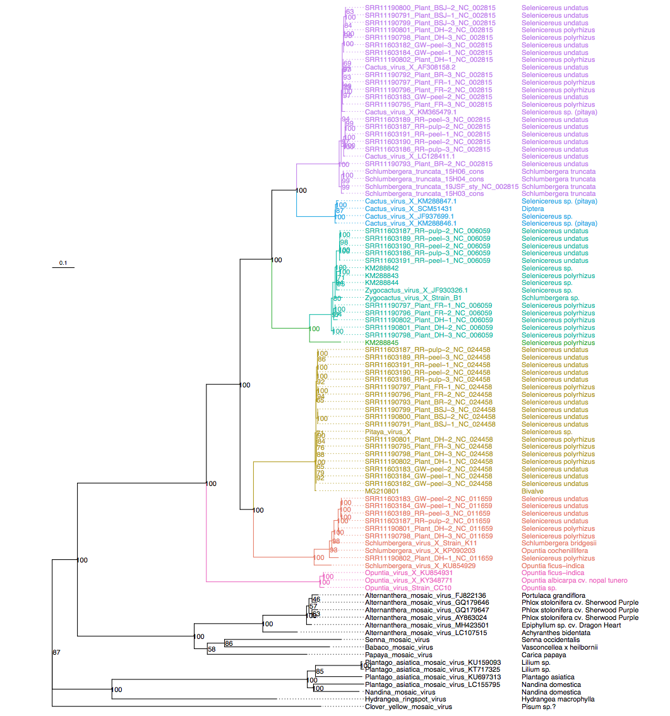
Clades are well-supported by gene trees and full-sequence bootstrap values.
However, the naming does not reflect the phylogeny… How can we fix this?
Notes:
Viral genomes are reconstructed from original RNA-seq sampling with very high coverage throughout (Mean coverages up to 120k). Blue highlighted tips are newly added, red are original Schlumbergera from B’s houseplants

Slide 4
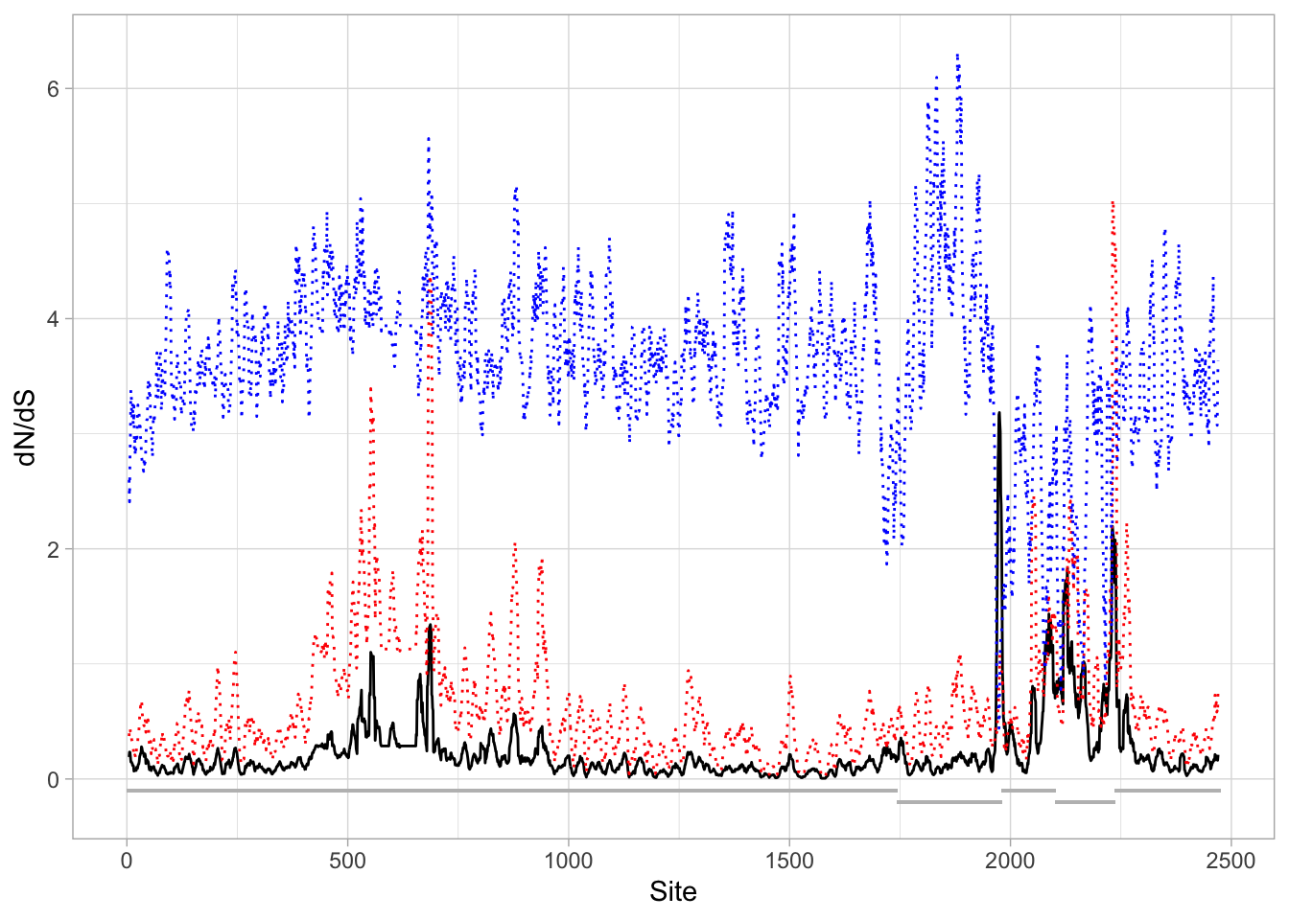
dS
dN
Notes:
Non-overlapping, appears to have many regions from 2000-2300 (not reflective of sequence bp numbering) that have dN/dS >1, indicating positive selection.

Slide 5
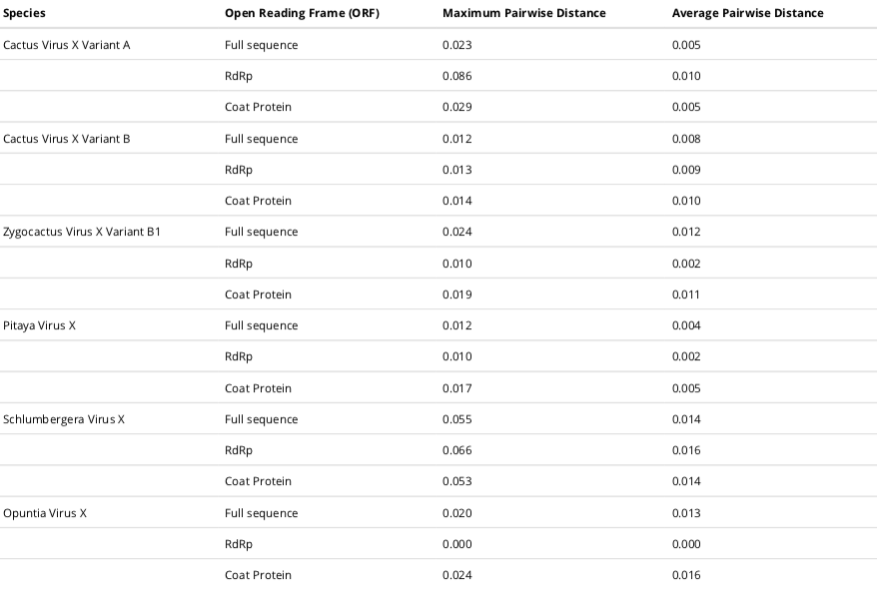
Well within ICTV’s 72% nt similarity thresholds (0.28 maximum pairwise distance)
Notes:
The best option right now seems to be “Variants” of a virus, which are not regulated by the ICTV. These variants can probably be named in the same style of Garlic Virus A, Garlic Virus B, and so on. The historical significance of strains such as “K11” and “B1” should probably be retained too. However, ICTV discourages significant changes to species names. The “species boundary” is reached pretty clearly by the CVX-like viruses. The ICTV rules state that the species should be monophyletic and be distinguished from other viruses by multiple properties. Our properties would include 1) inoculation/serological evidence, 2) pairwise distances/phylogenetic distance from other species, 3) host specificity(?), 4) physical differences in sequence length and viral appearance.
Notes on figure:
0-1 scale of distance,
0 being 100% similar and 1 being 100% different.

